Slide 1
Machine Intelligence Lab.
『Seminar for Thesis』
- ResNet -
20.11.10
Presenter : 강주연

Slide 2
Machine Intelligence Lab.
INDEX
Introduction
Residual Learning
Network Architectures
Experiments

Slide 3
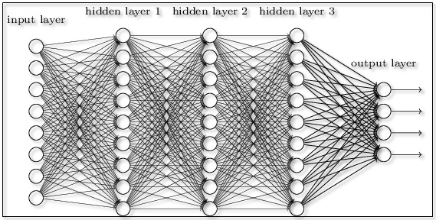
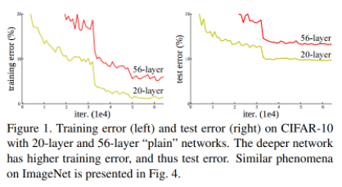
Machine Intelligence Lab.
01. Introduction
Network의 Depth를 늘이는 것만으로도 쉽게 성능을 향상 시킬 수 있을까?
어느 정도까지는 성능 향상, 그 이상은 Vanishing/Exploding gradient로 인하여 성능 저하
[Fig.1] Neural network architecture
[Fig.2] Error for layer

Slide 4
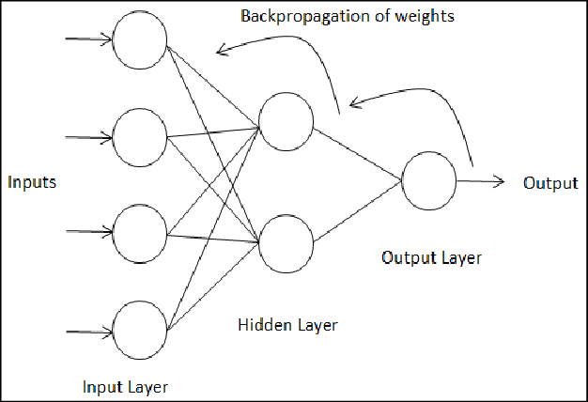
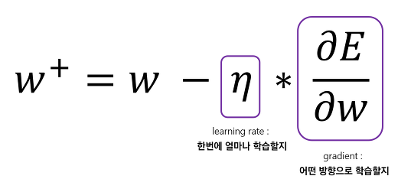
Machine Intelligence Lab.
01. Introduction
Gradient Vanishing : Backpropagation 에서 입력층으로 갈 수록 Gradient가 점차 작아지는 것(소실).
Gradient Exploding : Backpropagation 에서 입력층으로 갈 수 록 Gradient가 점차 커지는 것(폭등).
Degradation problem
[Fig.3] Backpropagation architecture
[Fig.4] Weight 계산 수식

Slide 5
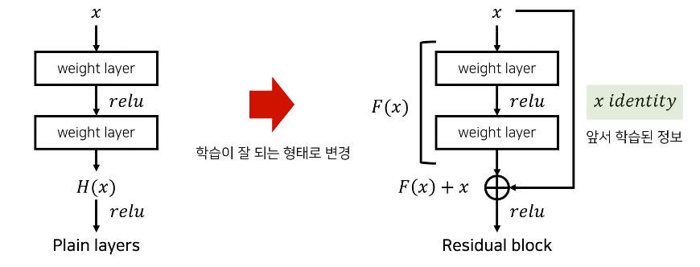
Machine Intelligence Lab.
02. Residual Learning
잔여 블록(Residual block)을 이용해 네트워크의 최적화(optimization) 난이도를 낮춤.
실제로 내재한 mapping인 H(x)를 곧바로 학습하는 것은 어려우므로 대신 F(x) = H(x) - x를 학습함.
[Fig.5] Plain layers & Residual block architecture

Slide 6
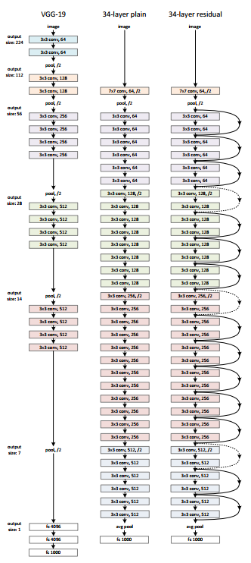
Machine Intelligence Lab.
02. Residual Learning
[Fig.6] ResNet architecture
[Fig.5] Plain layers & Residual block architecture

Slide 7
Machine Intelligence Lab.
02. Residual Learning
Input data : x , Output data : y
Network
x
Network
H(x)
: H(x)는 H(x)=y가 되도록 학습시킴.
: ex] if y=1 than H(x)=1
[Fig.7] Plain layers architecture

Slide 8
Machine Intelligence Lab.
02. Residual Learning
Input data : x , Output data : y
Network
x
Network
F(x)
+ x
F(x) + x
F(x) = 0
F(x) + x = x
∴ H(x) = x
H(x)
Residual block을 이용해 네트워크의 최적화 난이도를 낮춤.
[Fig.8] Residual layers architecture

Slide 9
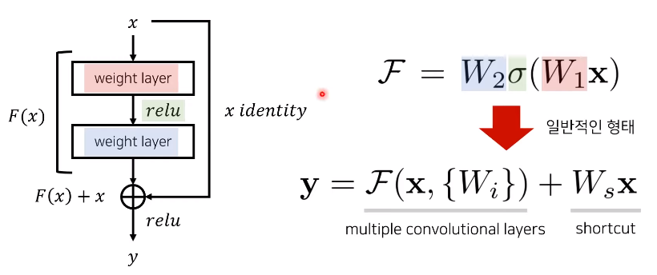
Machine Intelligence Lab.
02. Residual Learning
If this is not the case(e.g., when changing the input/output channels), we can perform a linear projection $W_{s}$ by the shortcut connections to match the dimensions
[Fig.8] Residual layers’ F(x) 수식

Slide 10
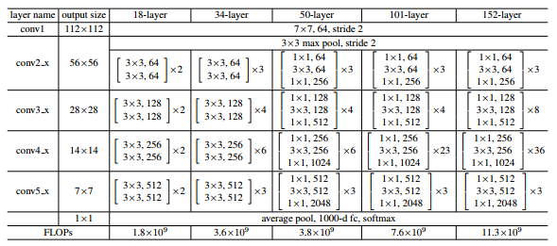
Machine Intelligence Lab.
03. Network Architectures
[Fig.6] ResNet architecture
[Fig.9] ResNet architecture for ImageNet

Slide 11
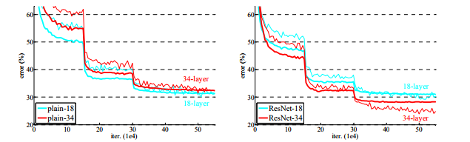

Machine Intelligence Lab.
04. Experiments
[Fig.10] Training on ImageNet
[Fig.11] Error on ImageNet validation

Slide 12
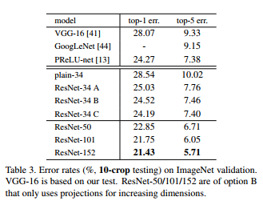
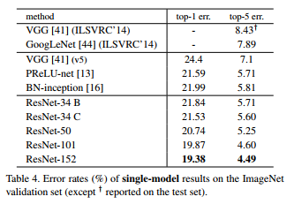
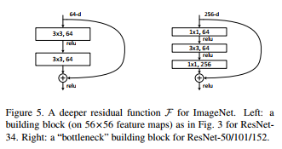
Machine Intelligence Lab.
04. Experiments
[Fig.12] Error rates
[Fig.13] Deeper Bottleneck Architectures

Slide 13
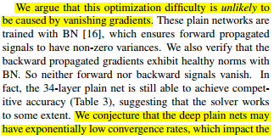
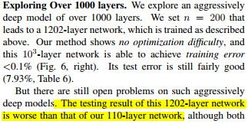
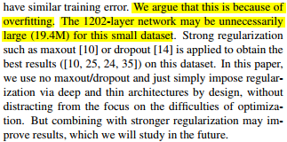

Machine Intelligence Lab.
04. Experiments
[Fig.14] Their discussion
[Fig.14] Exploring Over 1000 layers.

Slide 14
참고문헌
Kaiming He, Xiangyu Zhang, Shaoqung Ren, Jian sun, “Deep Residual Learning for Image Recognition”
https://www.houseofbots.com/images/news/1443/cover.png
https://images.deepai.org/glossary-terms/73eec54be08746f6b546a874580b8673/backpropagation.png
https://computer-nerd.tistory.com/18
https://curaai00.tistory.com/1
https://www.youtube.com/watch?v=671BsKl8d0E
https://ganghee-lee.tistory.com/41
https://wikidocs.net/61375
https://gomguard.tistory.com/183
https://leechamin.tistory.com/184

